Slide 1
Monitoring
End User Monitoring
Notes:
Notes to the Facilitator:
Welcome the participants and give them an overview of the module. Tell them that they will learn about the ‘End User Monitoring’ in this module.
Notes to the Participants:
You will learn about the ‘End User Monitoring’ in this module.

Slide 2
Module Objectives
At the end of this module, you will be able to:
Explain what is end user monitoring
Classify the types of end user monitoring
Describe the benefits of end user monitoring
Identify various available tool for end user monitoring
Notes:
Notes to the Facilitator:
Explain the module objectives to the participants.
Notes to the Participants:
You will be informed about the module objectives.
At the end of this module, you will be able to:
Explain what is end user monitoring
Classify the types of end user monitoring
Describe the benefits of end user monitoring
Identify various available tool for end user monitoring

Slide 3
Module Topics
This module covers the following topics:
Overview
Objectives of end user monitoring
Types of end user monitoring
Real user monitoring
Synthetic transaction monitoring
Server side monitoring
Benefits of end user monitoring
Tools overview
Notes:
Notes to the Facilitator:
Inform the participants about the topics that they will be learning in this module.
Notes to the Participants:
You will learn about the following topics in this module:
Overview
Objectives of end user monitoring
Types of end user monitoring
Real user monitoring
Synthetic transaction monitoring
Server side monitoring
Benefits of end user monitoring
Tools overview

Slide 4

1.1 Overview
Business owners should have a visibility over the impact your application has on their users.
The ideal way is end user monitoring.
Source: https://static1.smartbear.co/smartbear/media/images/product/alertsite%20uxm%20sb/real-user-monitoring_l.jpg
Notes:
Notes to the Facilitator:
Explain the overview of end user monitoring.
Notes to the Participants:
With the increase in digitalisation most of the business have extended to online, and for them to succeed it is important for it to reach users effectively. Most of the users now access applications running in IT, which requires to be healthy. But, most importantly we need the services to be up and running with customers’ point of view. Hence, it becomes necessary for business owners to have a visibility over the impact your application has on their users.
The ideal way to figure out impact on user of the application is via end user monitoring. Which is plainly monitoring the system from users end.

Slide 5
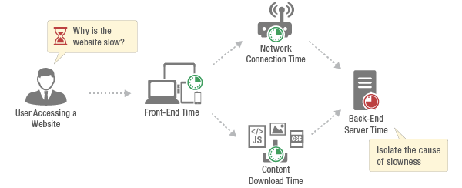
1.1 Overview (Contd…)
End user monitoring is:
Looking upon the user’s behaviour or activities while using the applications
Collecting the monitoring data and using this data for analysis
Source: https://www.eginnovations.com/blog/wp-content/uploads/2019/06/real-user-monitoring.png
Notes:
Notes to the Facilitator:
Explain the overview of end user monitoring to the participants.
Notes to the Participants:
In an ideal software development lifecycle, we build our applications and deploy them, which are further used by the end users, users interact with the applications and perform actions related to create, read, update and delete. A business owner needs to know how good is the user experience, it can also be said that that interaction helps us to understand the effect of application on user.
This kind of monitoring is nothing but looking upon the user’s behaviour or activities while using the applications. With this monitoring we are supposed to collect monitoring data and further use for analysis.

Slide 6
What did You Grasp?
Which monitoring happens from outside system?
End user monitoring
Infrastructure Monitoring
Application monitoring
Log Monitoring
Notes:
Notes to the Facilitator:
Answer:
A. End user monitoring

Slide 7

1.2 Objectives of End User Monitoring
We need certain key points on which we can assess the user experience:
Pinpoint the sectors of application with high/low fulfillment
Apprehend the performance of any new feature
Analyze the page load problems and remote script issues
Identifying the scope of improvement
Source: https://blogs.vmware.com/euc/files/2017/01/Intro-Feature.png
Notes:
Notes to the Facilitator:
Explain the objectives of end user monitoring.
Notes to the Participants:
From a high level, we understood that we want to know user’s experience for end user monitoring, but what are more granular objectives around it. We need certain key points on which, if we assess the user experience we can get a wholesome idea of the interaction.
Let us get to the points, which are important in this interaction.
Pinpoint the sectors of application with high/low fulfillment
Apprehend the performance of any new feature
Analyze the page load problems and remote script issues
Identifying the scope of improvement

Slide 8

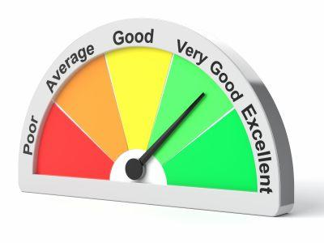
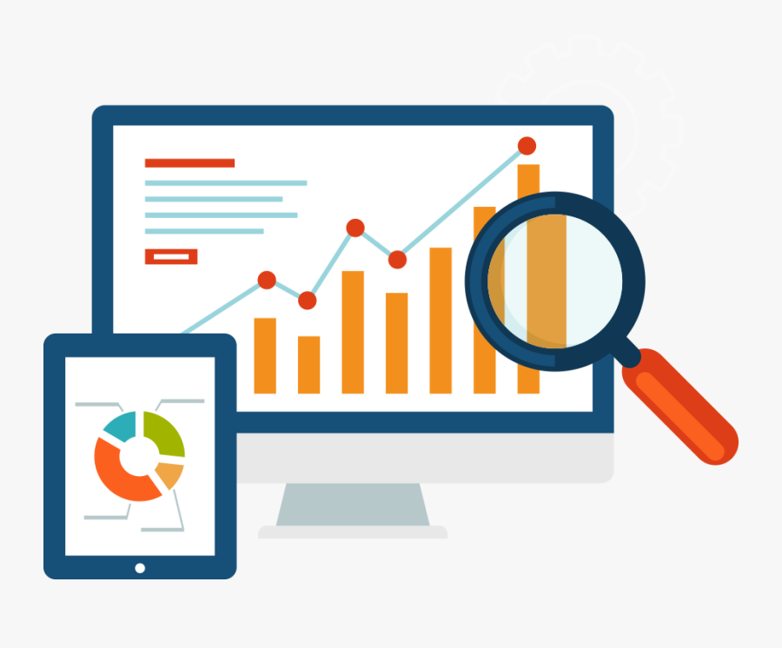

1.2 Objectives of End User Monitoring (Contd…)
The objectives of end user monitoring are:
Pinpoint the sectors of application with high/low fulfillment
Apprehend the performance of any new feature.
Analyze the page load problems & remote script issues.
Identifying the scope of improvement.
Notes:
Notes to the Facilitator:
Explain the objectives of end user monitoring.
Notes to the Participants:
The objectives of end user monitoring are:
Pinpoint the sectors of application with high/low fulfillment
An application has multiple parts which may or may not be identical based on your service. For example if you are building a fleet management website, you probably have classes like location, speed, ETA, fuel, etc. The end user monitoring helps us to identify which class of the application has good or bad impact on users.
The another aspect to it could be more visual like different composition of colors, fonts, templates, widget shapes in your web application. With the help of end user monitoring we can evaluate which composition provides better experience for users.
Apprehend the performance of any new feature
Once the application is out there for a while it becomes obligatory to enhance it with new features, while adding them it is important to know the impact of the feature on users, which is very crucial to understand whether the development is going on right path or not. The performance of a newly added feature can be analyzed by end user monitoring.
Analyze the page load problems & remote script issues.
One of the most common factor that pisses off the customers is slow page loads. When you get the information on user experience, the development will take place to improve that, without identifying issue we can not fix them. This can help us identify and fix loading of page and other network concern. The time taken by any web application has a key role in user experience because no user is patient enough to keep waiting for page to load.
Navigation problems can be easily identified via end user monitoring which will eventually get fixed also any other glitches in the web application related to design under ideal conditions.
Identifying the scope of improvement
With this whole some understanding of user experience we get insights of likes and dislikes of an user. After getting all such issues it will be easy to prioritize them and decide which issue needs to be focus earlier. With such planning and prioritizing the tasks will help in growing your business.

Slide 9
What did You Grasp?
How does one grow business?
By asking customers for feedback
By adding new features
By having insights of user experience with monitoring
By executing huge surveys
Notes:
Notes to the Facilitator:
Answer:
C. By having insights of user experience with monitoring

Slide 10



1.3 Types of End User Monitoring
Three types of end user monitoring are:
Real user monitoring
Synthetic transaction monitoring
Server side monitoring
Notes:
Notes to the Facilitator:
Explain the types of end user monitoring to the participants.
Notes to the Participants:
The end user monitoring has segregated into three parts mentioned below:
Real user monitoring
Synthetic transaction monitoring
Server side monitoring
We’ll further discuss in next slides.

Slide 11
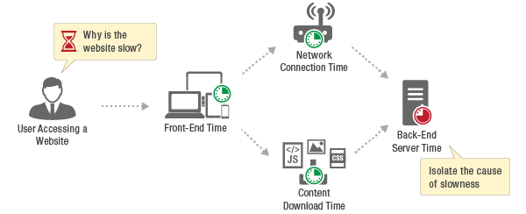
1.3.1 Real User Monitoring
The following image illustrates the real user monitoring.
Why is the website slow?
Network
Connection Time
User Accessing a Website
Front-End Time
Back-End
Server time
Isolate the cause of slowness
Content
Download Times
Source: https://www.eginnovations.com/blog/wp-content/uploads/2019/06/real-user-monitoring.png
Notes:
Notes to the Facilitator:
Explain the real user monitoring to the participants.
Notes to the Participants:
As the name implies, real user monitoring is keeping an eye on how actual users are interacting with the web application. The most authentic information regarding the end user’s experience can be retrieved by real user monitoring. It’s another name is passive monitoring.
The way to do aggregate data of real user monitoring is fundamentally from the web browser which are used by the user. JavaScript injections is highly used to capture real user data for this kind of monitoring.

Slide 12

1.3.2 How to do Real User Monitoring
The best way to do real user monitoring is by injecting java scripts.
Source: https://www.eginnovations.com/blog/wp-content/uploads/2019/06/real-user-monitoring.png
Notes:
Notes to the Facilitator:
Explain how to do real user monitoring to the participants.
Notes to the Participants:
As we discussed, the way to do this type of end user monitoring is by injecting java scripts, While building an application, we need to identify, which part of the application you want to collect data from. Later, a JavaScript code is injected to monitor user actions for that particular part of the application. The JavaScript code will be triggered on certain actions of the user and records the necessary data when the user uses your application.
Since, the data collected is based on actual user actions it is the most accurate one in real user monitoring. While writing the scripts in case of synthetic monitoring, the specific areas of user actions must be overlooked. Since those actions will be noted by using real user monitoring.
Apart from just capturing information about the user activity the real user monitoring also records vital information regarding views per page, version of browser, location of user, load time taken by page, etc.

Slide 13

1.3.3 Disadvantages of Real User Monitoring
The main disadvantage of real user monitoring is that the results are only dependable if the traffic count is decent enough.
It is only successful for the application, which are facing huge traffic.
Source: https://patrizeproperties.com/wp-content/uploads/2018/05/advantage-and-disadvantage-to-hiring-property-manager.jpg
Notes:
Notes to the Facilitator:
Explain the disadvantages of real user monitoring to the participants.
Notes to the Participants:
The operation side of application doesn’t get affected by implementing real user monitoring. The only main disadvantage of real user monitoring is that the results are only dependable if the traffic count is decent enough. If the traffic is not in bulk or very small number of users are engaged with application, the results will not be sufficient to take action on. It means real user monitoring is only successful for the application, which are facing huge traffic.

Slide 14
What did You Grasp?
The real user monitoring can be done with?
SQL Injection
Injecting Javascript
Shell scripts
C based executables
Notes:
Notes to the Facilitator:
Answer:
B. Injecting Javascript

Slide 15
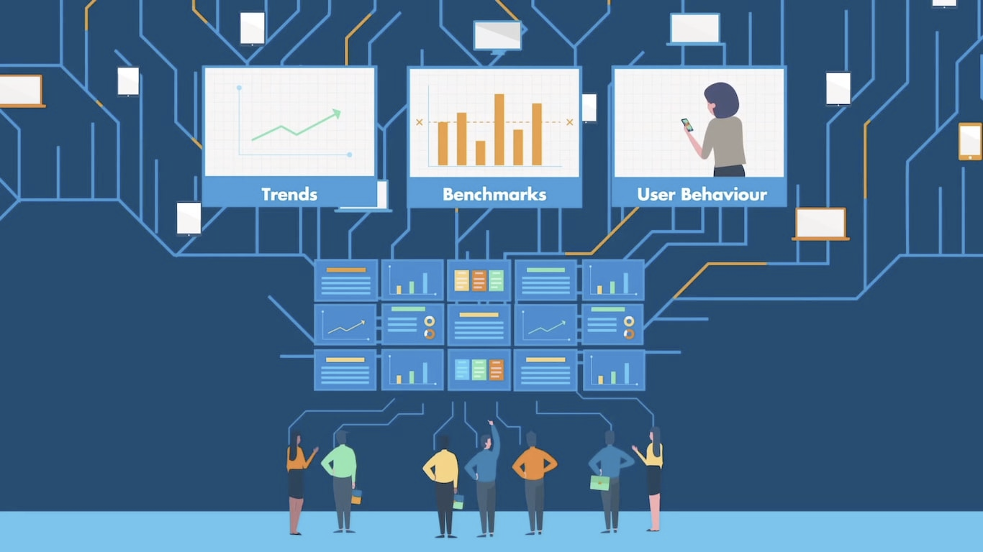
1.4 Synthetic Transaction Monitoring
In synthetic transaction monitoring:
Web browser emulation is heavily used
Web transaction are captured with scripted recordings regardless of users availability
Web application performance and availability issues are resolved from different geographical locations worldwide
Source: https://cloudqa.io/wp-content/uploads/2018/06/Synthetic-Monitoring.jpg
Notes:
Notes to the Facilitator:
Explain the synthetic transaction monitoring to the participants.
Notes to the Participants:
Active monitoring or proactive monitoring are the names coined for synthetic transaction monitoring. In this monitoring, web browser emulation is heavily used. Web transaction are captured with scripted recordings regardless of users availability which is kind of doing monitoring with simulation. Web application performance and availability issues are resolved from different geographical locations worldwide.
Typical usage of robot to monitor the end user experience is done in synthetic monitoring. Numerous scripts need to be created to simulate the user’s actions in your application in synthetic monitoring.
This may sound confusing, “Why simulation is being used to capture real user interaction? In case we need to monitor end user behavior, then actual user activity should be concerned then why we are using a robot to simulate user actions?”
This is done in order to get an understanding of the availability of your application and its performance. Also the plus point of using synthetic monitoring is that you can fix issues prior making the application available to your real users. Also, we are not relying on real users to analyze the performance of your application. This can be done by write a script to do what a real user would do and observe the behaviour of your application.

Slide 16
1.4.1 When and Why Synthetic Monitoring is Required
WHEN?
WHY?
To check the site availability 24/7
To raise customer satisfaction
To ensure the reliability of web applications
Notes:
Notes to the Facilitator:
Explain the Why & when of synthetic transaction monitoring.
Notes to the Participants:
The foremost point of using synthetic monitoring is to check the site’s availability. The other reason behind it is to observe end-to-end performance 24/7 from the end-users perspective. The performance of application can be predicted on the basis of geographical location to a fair degree and also to isolate the root cause of any detected issues. As per a survey, synthetic monitoring prevented 95 to 99 percent of previous performance issues for most of the customers.
Most of the business, which are online are highly dependent on 3rd parties for functionalities, like shopping carts, ads, customer reviews, web analytics, social networking, SEO, video, etc. to have a well off customer experience. These third parties highly help in enhancing the traffic, and raise customer satisfaction, but also bring vulnerability to weaken your site’s overall performance or even bring outage. And no matter whom to blame, but from the customer’s point of view, the owner is accountable. Using synthetic monitoring, we can evaluate components by doing various load testing, which are dependent on what to expect during high-traffic durations.
To ensure the reliability of web applications synthetic monitoring is the best way to do that. Every application these days experience from performance issues. The complex infrastructure and numerous integrations which are needed to support web application delivery in today’s age makes it even more vulnerable. With the synthetic monitoring it is way easy to up the game and stay \ahead of any problems in order to preserve customer base.

Slide 17
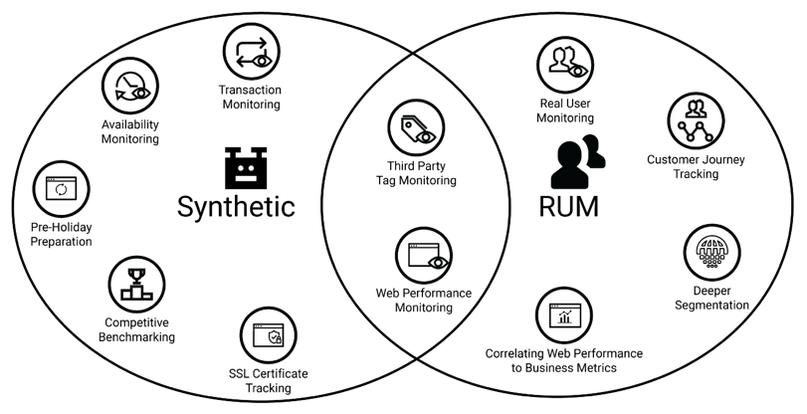
1.4.2 What Synthetic Monitoring is Not
Synthetic monitoring is not:
To resolve end user complaints
To troubleshoot servers and network problems
To determine the network or server performance
To show the analysis of the performance of each page in an application
Source: https://blog.bluetriangle.com/hs-fs/hubfs/synthetic-vs-real-user-monitoring.png?width=812&name=synthetic-vs-real-user-monitoring.png
Notes:
Notes to the Facilitator:
Explain to the participants what synthetic transaction monitoring is not.
Notes to the Participants:
It will not resolve end user complaints. It won’t tell anything about what the end user was actually doing or experiencing.
It won’t troubleshoot servers and network problems. Synthetic monitoring does not provide visibility into servers and network related problems.
It won’t determine the effect of server or network performance on the application performance.
It won’t show the analysis of the performance of each page in an application. The process of creating and managing the scripts involved in synthetic testing is really time-consuming, even for a single application.

Slide 18
What did You Grasp?
Which end user monitoring does not require user interaction?
Real user monitoring
Synthetic Monitoring
Server side monitoring
All of the above
Notes:
Notes to the Facilitator:
Answer:
B. End User monitoring

Slide 19
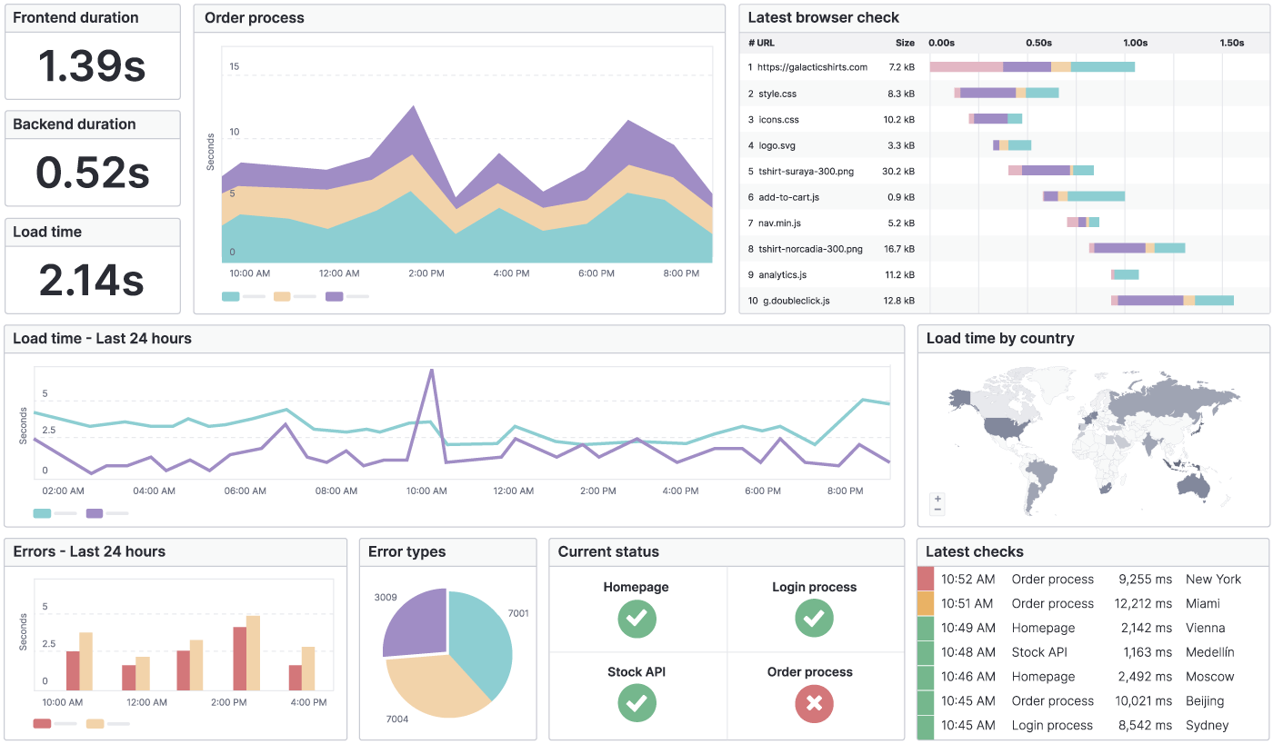
1.5 Server Side Monitoring
To get the information around the resource utilisation by the application on users device, server side end user monitoring is the best option.
Source: https://www.uptrends.com/Frontend/Images/hero-dashboard.png
Notes:
Notes to the Facilitator:
Explain the server side monitoring to the participants.
Notes to the Participants:
Application these days have complex architecture and multiplicity and using them heavily results in utilizing system resources to a great extent and this results in affecting the user experience. To get the information around the resource utilisation by the application on users device, server side end user monitoring can be leveraged.
The user might be accessing the application using various devices, like laptops, tablets, mobile phones, etc. You can use a small piece of code can be used to check the resources utilization by the application on the user’s device. That piece of code will aggregate data regarding devices utilisation and analysing that data will help you optimizing the application for various devices. The user’s experience improves when the optimization of the application is done and it runs smoothly on the user’s system.

Slide 20
What did You Grasp?
Server side monitoring helps us analyse the?
Performance of the servers
Performance of application
Resource utilisation by application on users device
Automatic fixing issues server side
Notes:
Notes to the Facilitator:
Answer:
C. Resource utilisation by application on users device

Slide 21

1.6 Benefits of End User Monitoring
The benefits of end user monitoring are:
Unfold the insights of interaction between humans and applications
Helps to explore new ways to improve and optimise the performance of your applications and web resources
Ensures good user experience that leads to less pressure on Help desks and Technical support services
Notes:
Notes to the Facilitator:
Explain the benefits of end user monitoring to the participants.
Notes to the Participants:
The benefits of end user monitoring are:
End user monitoring can unfold the insights of interaction between humans and applications, experience your mobile apps and websites, with particular emphasis on the correlation between site or app speed (responsiveness) and user satisfaction. With these observations we can explore new ways for you to improve and optimise the performance of your applications and Web resources.
It is an important aspect for a business enterprise to ensure that the user has a good experience during the application usage. End user monitoring helps you understand user experience, and ruling out the problems leading to a bad user experience.
Knowing how your users react to an application or website can suggest your best strategies for updating or tweaking these resources for future use. It can also suggest where investments may be most effectively targeted to improve your services, and how the overall experience for your customers may be improved.
If a customer is satisfied then it eventually lead to less pressure on Help desks and Technical Support services, and it gives privilege to organisation to concentrate its efforts on your business objectives, and providing even better services and products to your clients.

Slide 22
What did You Grasp?
Which monitoring gives us insight about the user and application interaction?
End user monitoring
Infrastructure monitoring
Application monitoring
Log monitoring
Notes:
Notes to the Facilitator:
Answer:
A. End User monitoring

Slide 23
1.7 Tools Overview
There are some key points to evaluate a good end user monitoring tool:
It should be as easy as navigating the website.
It should have plug-in-play mechanism.
The ease of integrating tool should be free from much hassle.
The tool should provide deep and granular insight.
A wholesome should provide all types of end user monitoring.
Notes:
Notes to the Facilitator:
Give an idea about the available tools for end user monitoring.
Notes to the Participants:
There are some key points to evaluate a good end user monitoring tool:
It should be as easy as navigating the website like real users.
It should have plug-in-play mechanism
The ease of integrating tool should be free from much hassle
The tool should provide deep and granular insight.
A wholesome should provide all types of EUM.

Slide 24
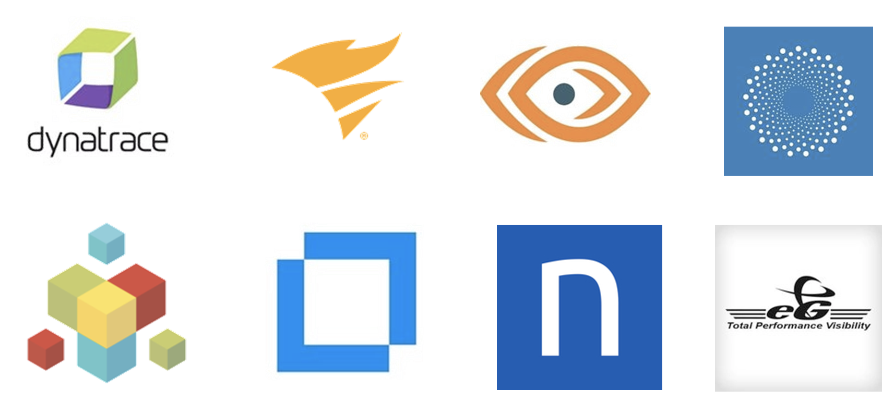
1.7 Tools Overview (Contd…)
Some tools available in market:
Notes:
Notes to the Facilitator:
Give an idea about the available tools for end user monitoring.
Notes to the Participants:
There are some prominent tools in market, which provide exceptional end user monitoring.
Dynatrace
SolarWinds Pingdom
ThousandEyes
Catchpoint
AppNeta
MicroFocus
Nexthink
eG enterprise

Slide 25
What did You Grasp?
End user monitoring does not provide insight of?
Application performance
Resource utilisation of servers by applications
Web browser page load
Insights about events happening in system
Notes:
Notes to the Facilitator:
Answer:
D. Insights about events happening in system

Slide 26
In a Nutshell
In this module, you learnt:
Overview of end user monitoring
The objective of end user monitoring
The classification and types of end user monitoring
Advantages of end user monitoring
Brief overview of tools available to do end user monitoring
Notes:
Notes to the Facilitator:
Share the module summary with the audience.
Ask the participants if they have any questions. They can ask their queries by raising their hands.
Notes to the Participants:
Now, you have reached the end of the module, In this module, you learnt:
Overview of end user monitoring
The objective of end user monitoring
The classification and types of end user monitoring
Advantages of end user monitoring
Brief overview of tools available to do end user monitoring

Slide 27
Next Module 3: Infrastructure Monitoring

